Slide 1
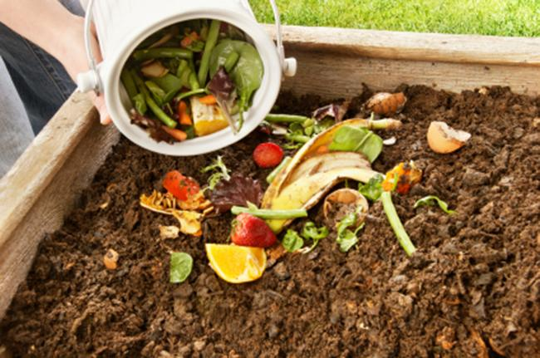
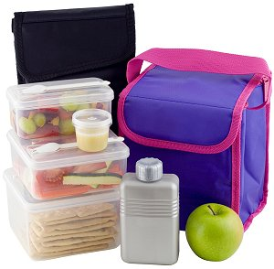
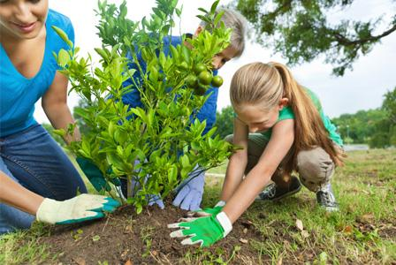
Good for the environment

Slide 2
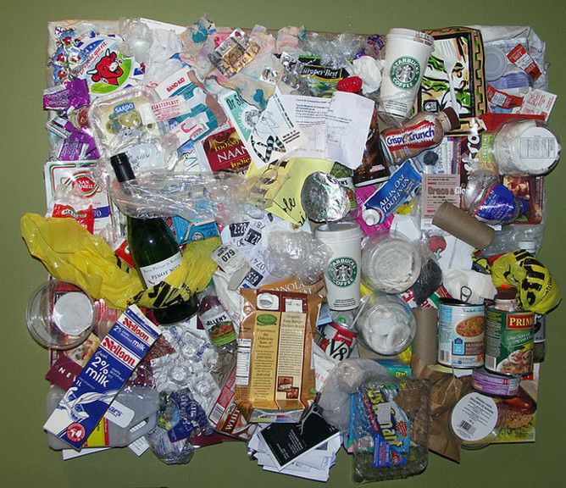
Good for the environment?

Slide 3
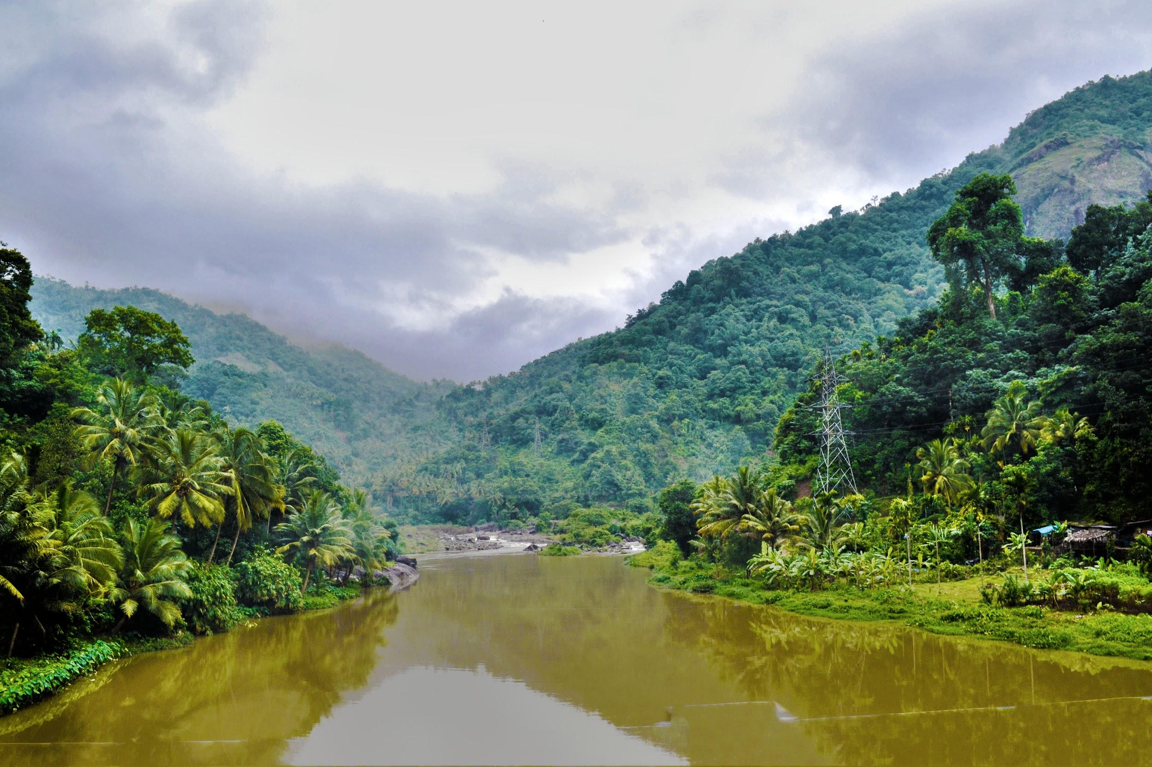
Creator God,
We praise and thank you for the beauty and goodness of creation around us
Lord, grant us the wisdom to care for the earth and treasure it.
Help us to act now for the good of future generations
and all your creatures.
Help us to become instruments of a new creation,
founded on the covenant of your love.
Amen.

Slide 4
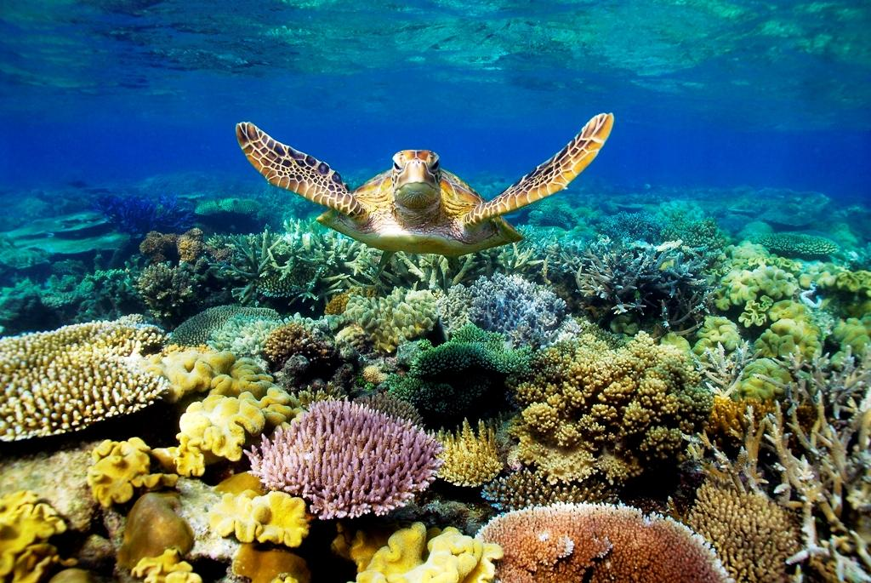
Scripture Reading: Psalm 8
Lord our God, the whole world tells the greatness of your name.
Your glory reaches beyond the stars.
Even the babble of infants declares your strength, your power to halt the enemy and avenger.
I see your handiwork in the heavens: the moon and the stars you set in place. What is humankind that you remember them, the human race that you care for them?
You treat them like gods, dressing them in glory and splendour.
You give them charge of the earth, laying all at their feet: cattle and sheep, wild beasts, birds of the sky, fish of the sea, every swimming creature.
All: Lord our God, the whole world tells the greatness of your name.

Slide 5
Prayer of the faithful
We pray for Pope Francis, may he continue to share the message of caring for creation. Lord hear us.
We pray for Governments, may they work hard to save the environment. Lord hear us.
We pray for ourselves, may we be willing to make changes to our lives so that we may care for our environment. Lord hear us.
We pray quietly in our hearts for all our other intentions. Lord hear us.
Creator God, hear all our prayers spoken out aloud and in the silence of our hearts.
AMEN

Slide 6
Closing Prayer
Creator God,
Help us to take up the challenge of litter free lunches and nude food. Help us to educate our parents so that they understand why it is so important to care for creation.
We ask this through Christ our Lord.
AMEN

Slide 7
WHAT IS NUDE FOOD?
Nude Food is simply food that is not wrapped in foil, plastic or
any type of packaging. This reduces the amount of 'stuff'
that needs to go in bins to be sent to landfill.
The best type of nude food consists mainly of fresh food, so that it is healthy and nutritious PLUS environmentally friendly.
THE KEY IS TO MINIMISE THE AMOUNT OF RUBBISH!
For a Nude Food Lunchbox, try to pack …
Snacks in reusable containers Drinks in a reusable container
Reusable utensils when needed A reusable lunchbox or backpack

